Slide 1
Detect AI
2410030140 -
2410030339 -
2410030337 -
Ch. Jaswanth Reddy
B. Karthik Reddy
K. Mani Vardhan Reddy

Slide 2
Table of Contents
Introduction | Introduction to this project
Feasibility analysis | Technical requirements and resources
Literature survey table | Related information about the project
Applications | Applications of the project
Conclusion | The final result and output expected from the project

Slide 3
Introduction
Text Analysis:
The system reads any text input and examines patterns in how words are used, how sentences are structured, and the overall writing style
Smart Detection:
Uses trained algorithms that have learned to recognize the differences between how humans write versus how AI writes
The project "Detect AI" is a machine learning system that analyzes text to determine whether it was written by AI or a human. With the rise of AI writing tools like ChatGPT and Claude, it has become difficult to tell the difference between AI-generated content and human writing. This project solves that problem by creating a tool that can identify the source of any text.

Slide 4
Feasibility Analysis
Techniques
Combines TF-IDF vectorization, ensemble learning, and feature extraction
Python
Data
Uses proven ML libraries (scikit-learn, NLTK, NumPy)
Supports incremental improvements and model refinement

Slide 5
Literature Survey Table
Year |  | Title |  | Techniques |  | Accuracy | Limitations
2024 |  | BERT Guard |  | BERT, Deep Learning, TF-IDF, 60/40 Split |  | 99.72% | Requires large dataset
2024 |  | TextTwin |  | Naive Bayes, Logistic Regression, TF-IDF |  | 98.0% | Small dataset, binary only
2024 |  | InsightX |  | XGBoost, SVM, BERT, Feature Engineering |  | 93.0% (BERT) | High computational cost

Slide 6
Literature Survey Table
Year |  | Title |  | Techniques |  | Accuracy | Limitations
2024 |  | StyleSleuth |  | Random Forest, Linguistic & Stylistic Features |  | 99.72% | Requires large dataset
2024 |  | GANSeal |  | GAN Feature Extraction, Weighted RF, Ensemble |  | 99.60% | Computationally intensive
2024 |  | DeepDetect |  | Transformer, LSTM, CNN, Normalization |  | 99.0% | High resource needs

Slide 7
Literature Survey Table
Year |  | Title |  | Techniques |  | Accuracy | Limitations
2023 |  | BoundGuard |  | Information Theory, Sample Complexity |  | N/A | Theoretical only
2022 |  | LLMFusion |  | Ensemble of Pre-trained LLMs |  | N/A | High compute overhead
2021 |  | NewsShield |  | TF-IDF, Stacking Ensemble, Feature Selection |  | 75.48% | Spanish news only

Slide 8
Applications
Check if students used AI to write their assignments and homework
Verify that articles and blog posts are written by real people
Detect fake reviews and AI-generated comments on websites
Check employee reports and official communications for authenticity

Slide 9
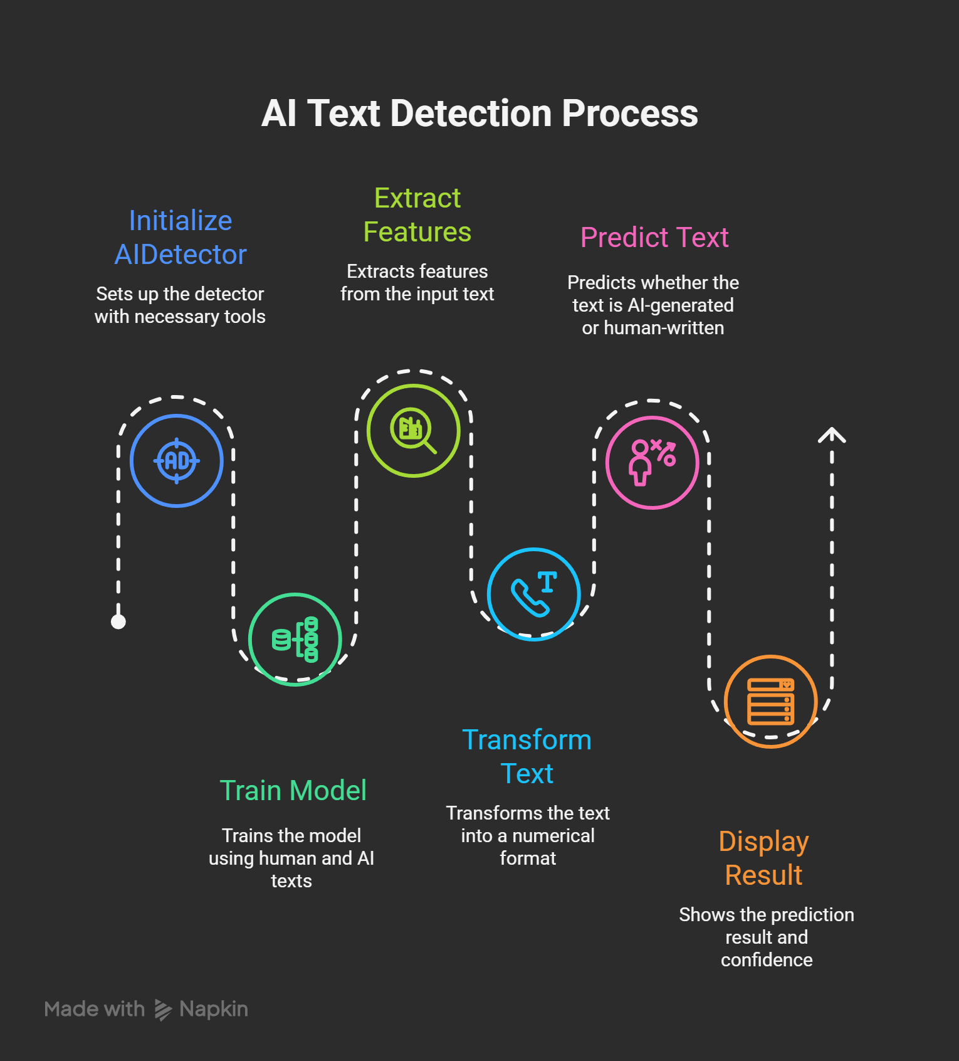
Conclusion
The project aims to create a simple and accurate tool that can tell whether any text was written by AI or a human. This will provide a reliable solution for distinguishing between artificial and authentic content in various situations.

Slide 10

Thank You!

